Slide 1
Pokémon Shuffle

Slide 2
Why shuffle?
Play! Pokémon TCG Rules and Formats Section 7: Shuffling

Slide 3
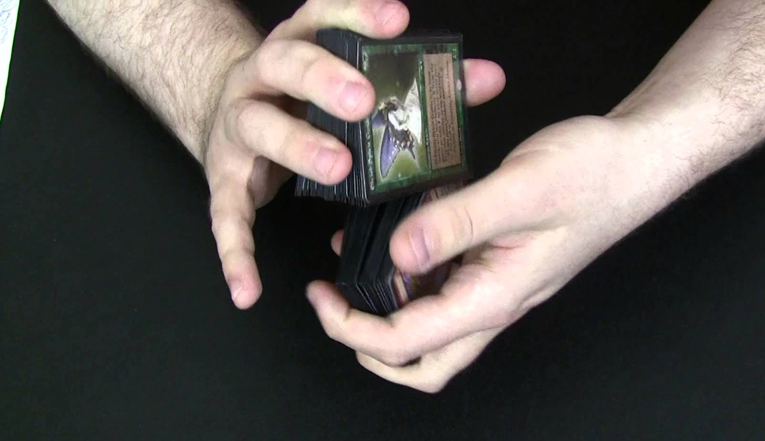
Shuffling methods:
Pile
Hindu
Mash
Riffle

Slide 4
Sufficiently Randomized What are we looking for: What methods and how many What do we NOT want to see: Angle of deck “Checking” cards Top card and bottom card “Peeking”

Slide 5
Insufficiently Shuffled Deck: Now what? Game Play Error: Major Tier 1: Warning – Tier 2: Prize Penalty Game Play Error or Cheating? Pattern Penalize it early – set the standard

Slide 6
Players in Distress Line ‘em Up Two Rows Back & off to the Side
What to look for on the floor

Slide 7
Cutting Refusing to offer or suspicion of order When is a cut a shuffle?

Slide 8
Sleeves & Marked Cards

Slide 9
Legal Sleeves 1. All the same 2. Solid colors 3. Clear or none………….. 4. OFFICIAL Pokémon Sleeves 4a. …with Solid Borders

Slide 10
Penalty Guidelines 8.2 (Feb ‘18) Minor – no pattern Major - pattern Severe Cheating – deliberate/repeated Likelihood – Potential - Ease

Slide 11
Different sleeves – color, length, finish Scuffs and dings Bends Thickness Curves

Slide 12
Pattern vs no Pattern Makes ALL the difference

Slide 13
Cheating versus mistake…

Slide 14
Questions and Discussion

