Slide 1
Slow Playing
By: Corey Scott

Slide 2
8.4. Game Tempo
The pace of a Pokémon TCG match should be lively without being excessively fast, and each player should receive approximately half of the allotted time for the game. However, the way players react to pressure can have an impact on the tempo at which they take their turns. Judges should watch for changes in tempo and make corrections if needed.
In general, the following time limits for various game actions should be appropriate.
The times given below are general guidelines; players attempting to compartmentalize their turn in order to use every second of the time allowed for the items below are almost certainly stalling and should be subject to Unsporting Conduct penalties.
❖ Performing the actions of a card or attack: 15 seconds
❖ Shuffling and setup, game start: 2 minutes
❖ Shuffling and deck search, mid-game: 15 seconds
❖ Starting the turn after opponent’s “end of turn” announcement: 5 seconds
❖ Considering the game position before playing a card: 10 seconds
Notes during a game should be taken using the same time limits listed above. For example, a player making a note about a mid-game deck search must do so in the same 15 seconds allowed for the action.
Notes:
Remember, these are guidelines, not specific rules. What this means is that as long as players are over all, with in these guidelines they are ok.
Exceptions:
Frist deck search
Taking a moment to think, then completing several actions in a row quickly
If they are taking to long on multiple actions in a row then, (next Slide)

Slide 3
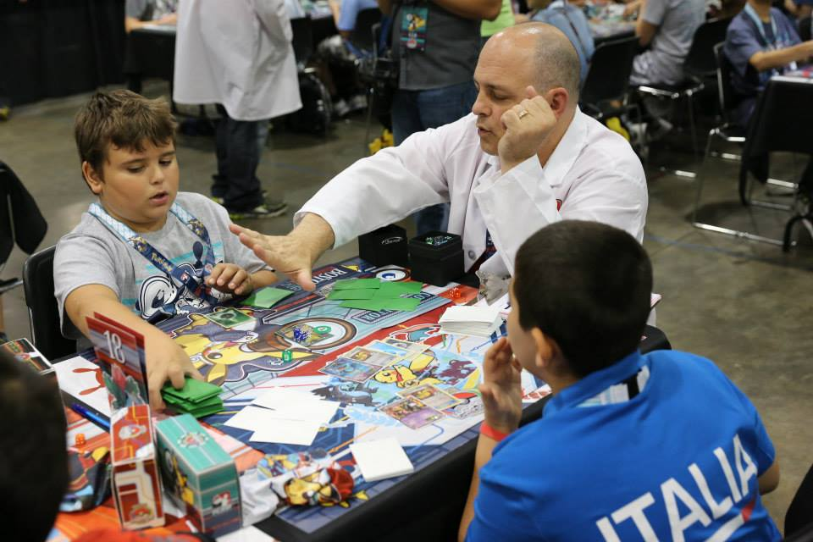
7.4.1. Slow Play
Players should take care to play in a manner that keeps the game pace lively, regardless of the complexity of the situation. A player who takes too long to make decisions about gameplay runs the 14 Play! Pokémon—Trading Card Game Penalty Guidelines Date of last revision: November 2, 2017 risk of putting their opponent at a disadvantage due to the round’s time limit. In addition to the recommended penalty, the judge may issue a time extension to offset this disadvantage.
Slow play penalties should escalate to Prize Card penalties after the first warning, but should not exceed a Prize Card penalty.
Examples of Game Tempo:
Slow Play include:
• You are excessively slow when deciding which Pokémon to attach an Energy card to.
• You take an unreasonable amount of time deciding which Basic Pokémon to take from your deck after playing a Poké Ball card.
• Counting or searching your (or your opponent’s) deck or discard pile more than once in a short time period.
• Repeatedly searching your deck, hand, or discard pile while performing a card effect.
• Attempting to engage in extraneous conversation that interferes with timely play.
Recommended Starting Penalty:
Tier 1: Caution
Tier 2: Warning
Notes:
Once you start getting out of the times recommended in the guidelines is when you start getting into what may be a slow play penalty. When a player is making multiple actions in a row that go past the time what the guidelines say. This is slow play. Yes, game situations can be stressful and they are just checking to make sure that every last card they need is in their deck. They do not have 50 plus three to check this. Game actions need to be taking to progress the game. Players need to play as such. When giving a player a slow play warning, make sure that they know that in the future the penalty for this will be escalated. The escalation is to a prize card penalty. The penalty for slow play should never go past a prize card penalty.

Slide 4
7.6.2. Major
Players are expected to behave in a respectful manner to all attendees and staff of a Pokémon event. Players who don’t behave properly need to be reminded with the issuance of a penalty. Infractions in this category have a direct impact on event operation or cause a small degree of emotional distress to those around them.
Examples of Unsporting Conduct: Major include:
• Leaving a large amount of garbage in the tournament area.
• Failure to comply with the instructions of the event staff.
• Engaging in gamesmanship or rules lawyering.
• Attempting to manipulate a match through intimidation or distraction.
• Refusal to sign a match slip.
• Making legal plays that have no effect on the game in progress to manipulate the time remaining in a match.
• Playing slowly to manipulate the time remaining in a match.
Recommended Starting Penalty:
Tier 1: Game Loss
Tier 2: Game Loss
Notes:
Slow play is more for the people playing to slowly by mistake. Some people may actually be stalling their opponent and that has a very different set of penalties. Stalling is different than slow play. Slow play is where you believe that the player is unintentionally doing it. If you believe that a play is playing slowly on purpose that is unsportsman like conduct and is a higher penalty. Your head judge will be involved on this since it is a game loss.

Slide 5
JUDGE!!! My opponent is slow playing…
Recommended course of action:
Both players responsibility to have a steady pace of play
Stand on game for a moment
Watch from a few tables back
Watch a couple turns by both players to make sure they are keeping up the pace of play
Notes:
Remind both players that it is their duty to keep up the pace of play. Tell the players that they may continue playing and stand on the game, just for a moment/ Then, go to few tables back. Players will continue to play at a steady pace if a judge is standing there on their game. (Insert personal story: EUIC)

